Slide 1

Outland Adventure Case Study Presentation CSd310 – 11.2 Assignment

Slide 2
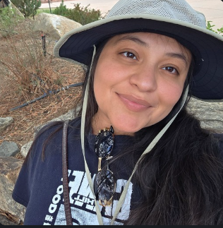
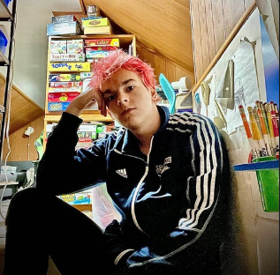
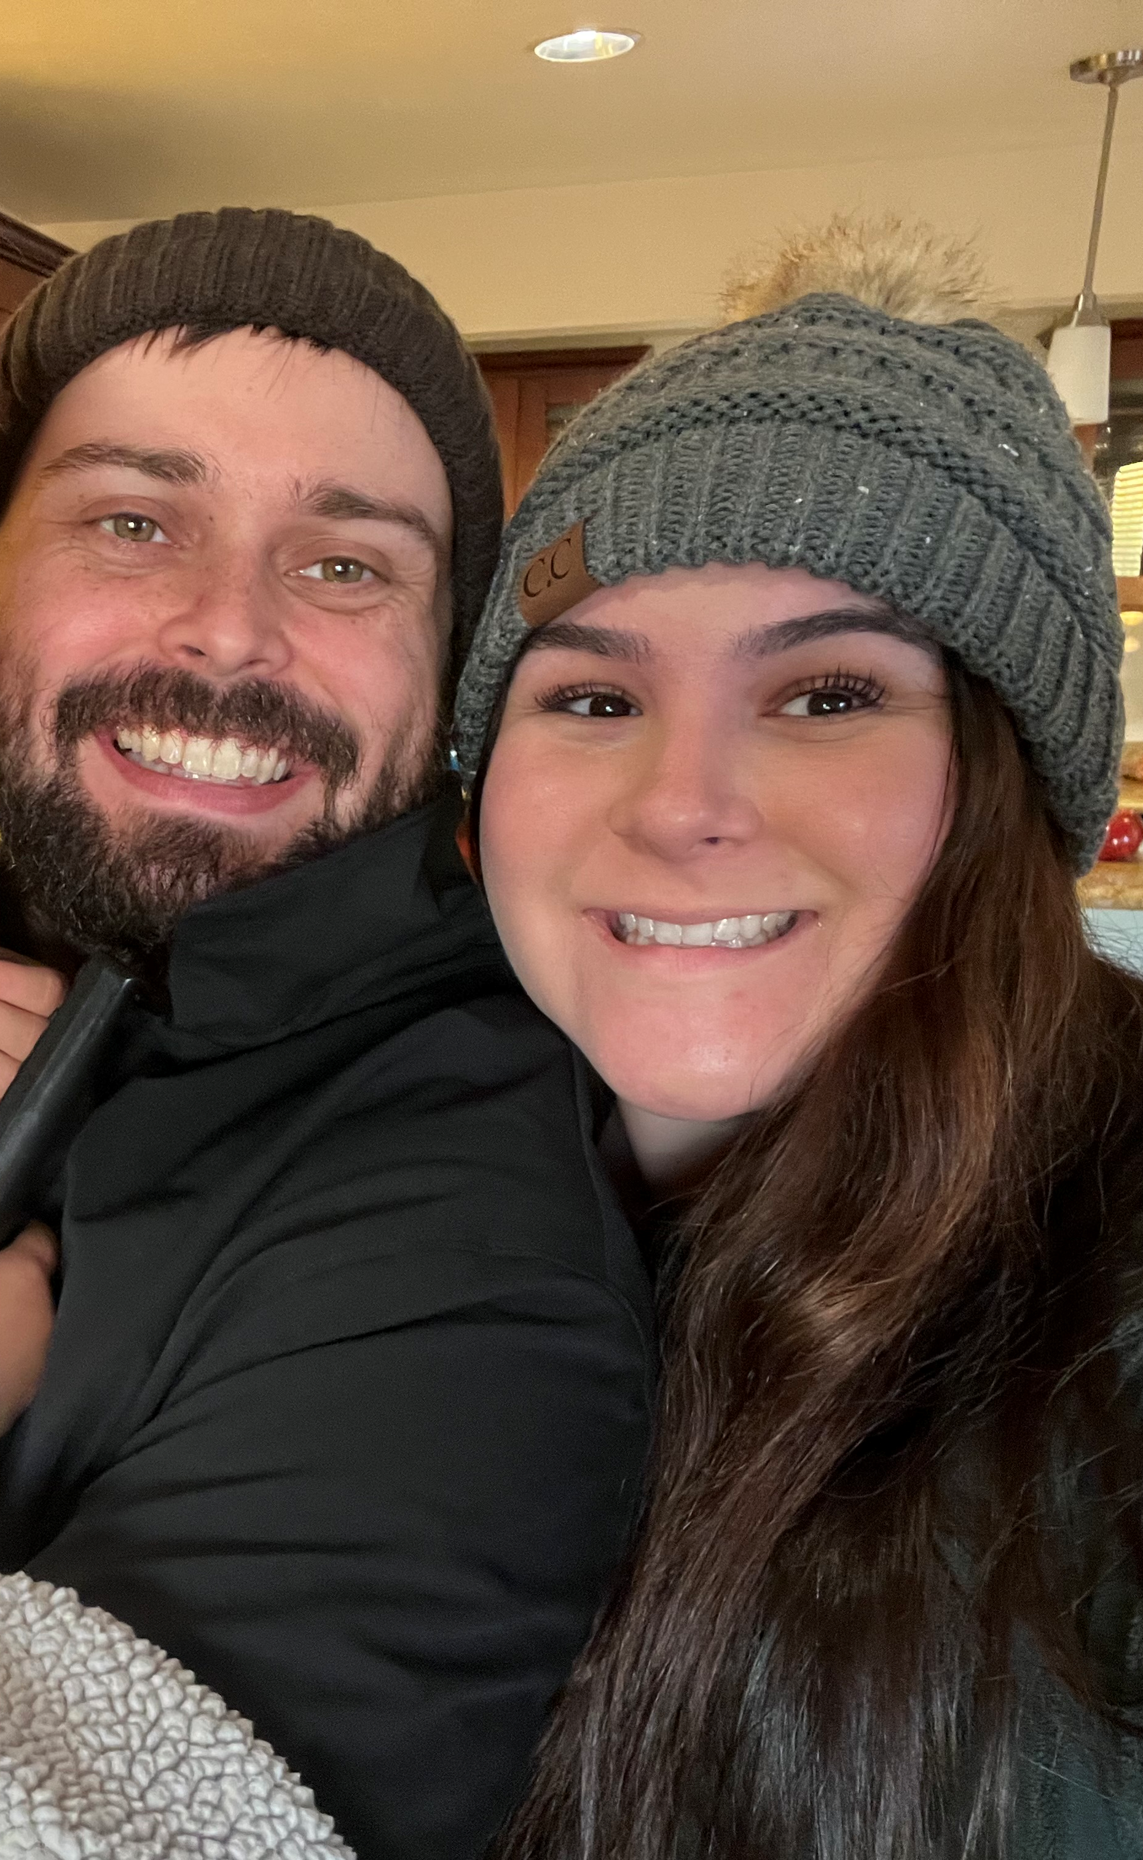
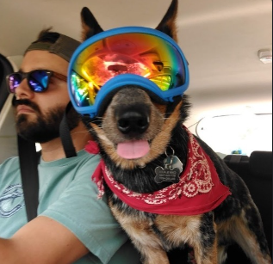
Group Introduction
Meet Our Team:
Angela Vargas
Tevyah Hanley
Zachary Anderson
Cameron Mendez

Slide 3

Case Study Overview

Slide 4
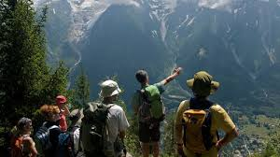
Outland Adventure: Business
Founded by Blythe Timmerson and Jim Ford, outdoor enthusiast
Initially part-time, but grew into a full-time adventure travel business
Services: guided hiking/camping trips, gear sales & rentals
Staff includes guides, marketing specialist, inventory manager, and new eCommerce developer

Slide 5
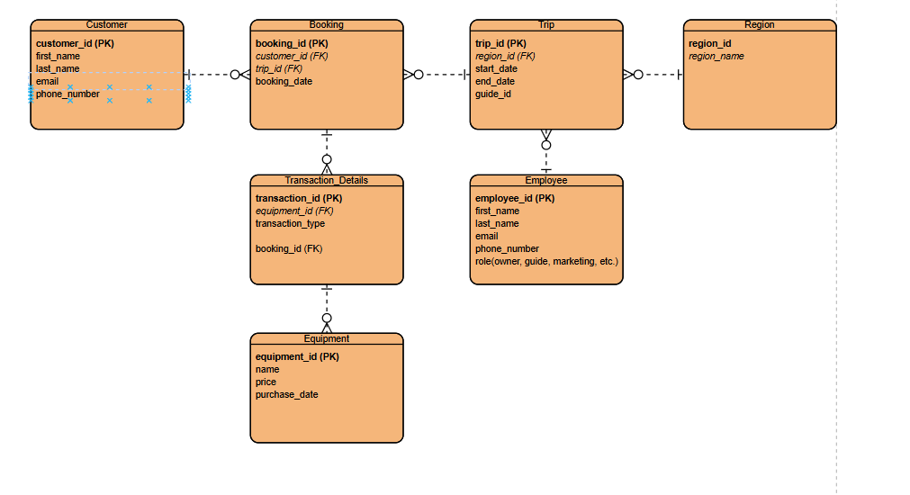
Outland Adventure: Final ERD

Slide 6
Key Goals
Optimize
Optimize operations
Improve
Improve decision-making with data
Analyze
Analyze sales, trends, and inventory

Slide 7
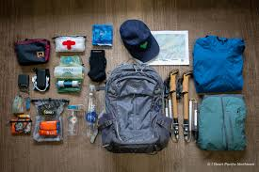
Key Business Questions
Outland Adventure asked us to help answer:
Are equipment sales worth continuing?
Are bookings declining in any specific region?
Are there aging inventory items needing replacement?

Slide 8

Equipment Sales Vs Rentals – Report 1
Question: Do enough customers buy equipment to keep sales going?
What we measure:
Total equipment sold vs rented
Revenue from each
Assumptions: each transaction record included the type (sale/rental) and associated cost

Slide 9
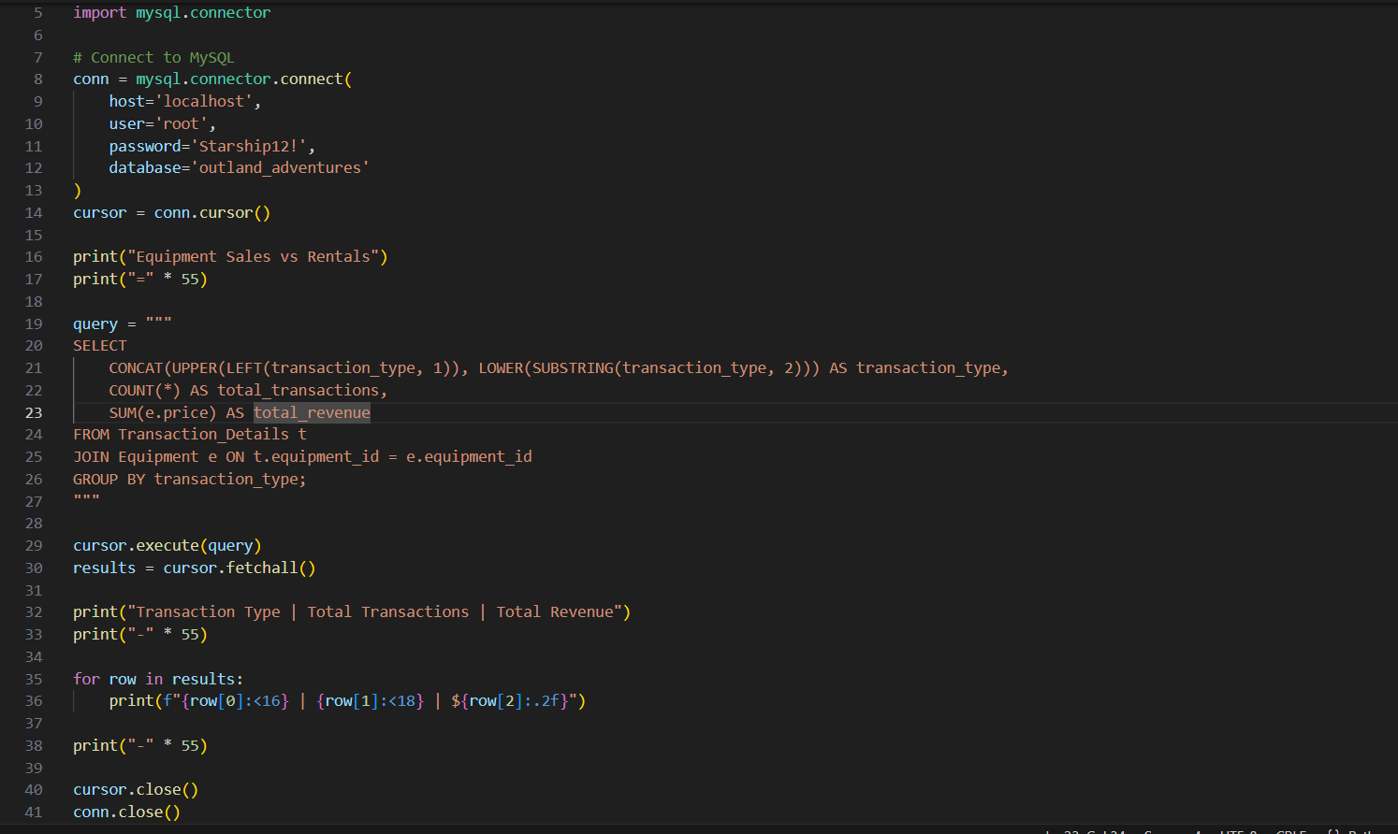
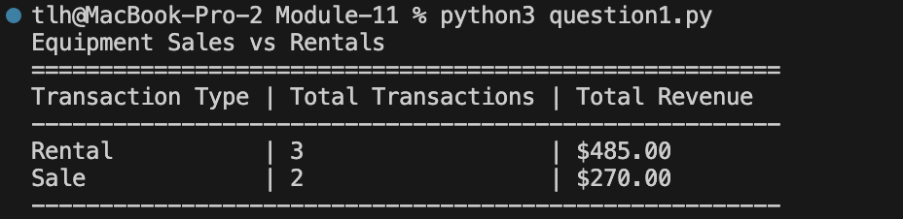
Report 1 – Sample Output
Insight: While rentals are more frequent, sales generate higher revenue. Maintaining both models is advisable.

Slide 10
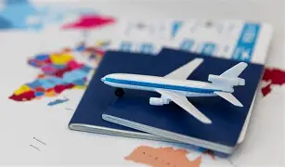
Booking trends by region– Report 2
Question: Is there a downward trend in bookings in Africa, Asia, or Southern Europe?
What we measure:
Annual bookings grouped by region and year
Assumptions: Bookings data contains region and date of trip

Slide 11
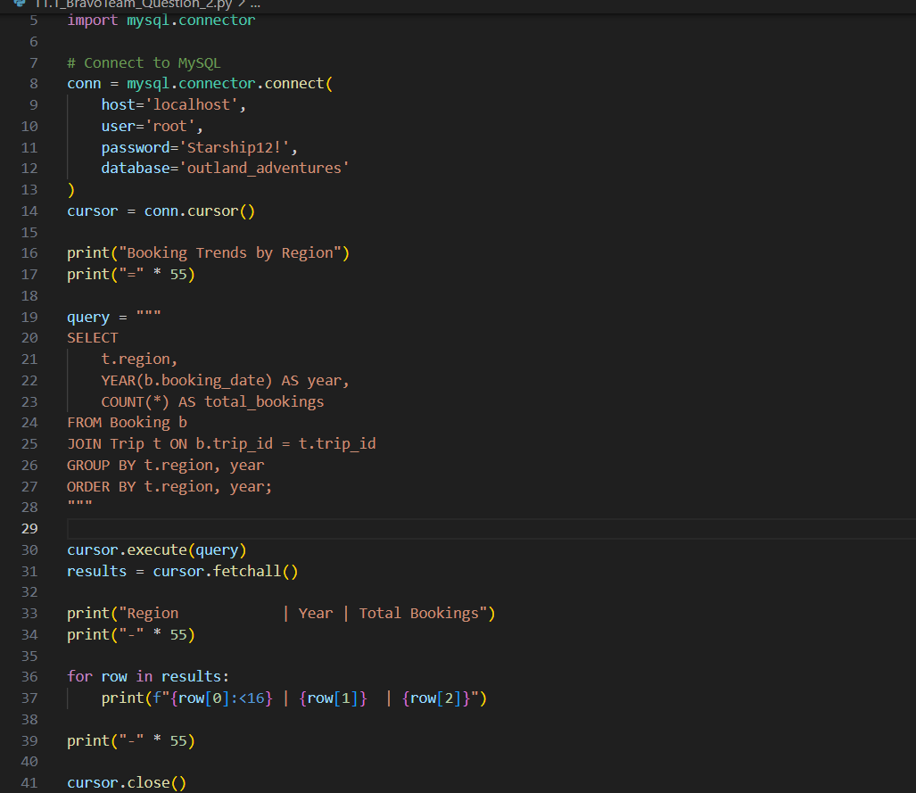
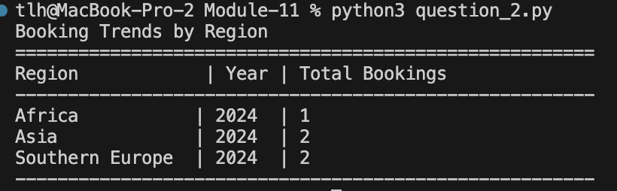
Report 2 – Sample Output
Insight: Southern Europe is experiencing a clear decline. Consider reducing trips or increasing marketing there.

Slide 12

Aging Inventory – Report 3
New!
5 Years Old
Question: Are there inventory items over 5 years old?
What we measure:
Equipment purchase date
Current item age
Assumptions: The database includes each item’s purchase date and unique ID.

Slide 13

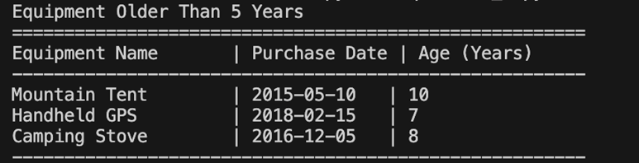
Report 3 – Sample Output
Insight: Several items exceed 5 years. Recommend replacement for safety and quality.

Slide 14
Thank you
Bravo Team – CSD310 – 11.2 Assignment

